Slide 1
Autoencoders & RBMs
Simplified | ARtists

Slide 2
Autoencoders
Feature Learning
They encode input, usually by compressing large vectors into smaller vectors that capture their most significant features
They are useful for data compression (dimensionality reduction) as well as data reconstruction for unsupervised learning.
Generative Algorithm vs Discriminative Algorithm

Slide 3
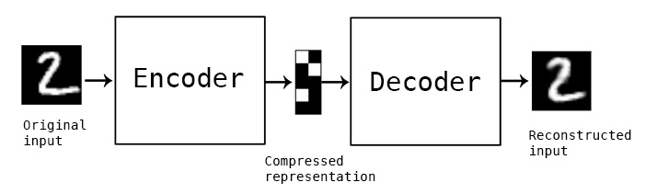
What?

Slide 4

Seriously?

Slide 5
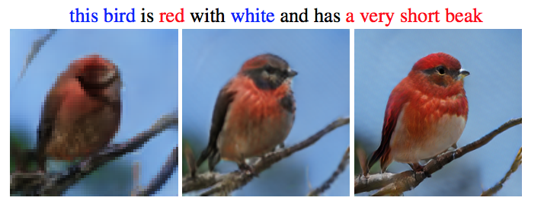
What else?

Slide 6

And?

Slide 7
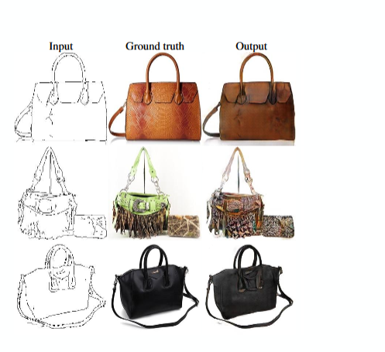
And?

Slide 8
Restricted Boltzmann Machine
Invented by Geoffery Hinton – University of Montreal
Algorithm for Feature Learning
Music, Text, Classification
Latent Features Only

Slide 9
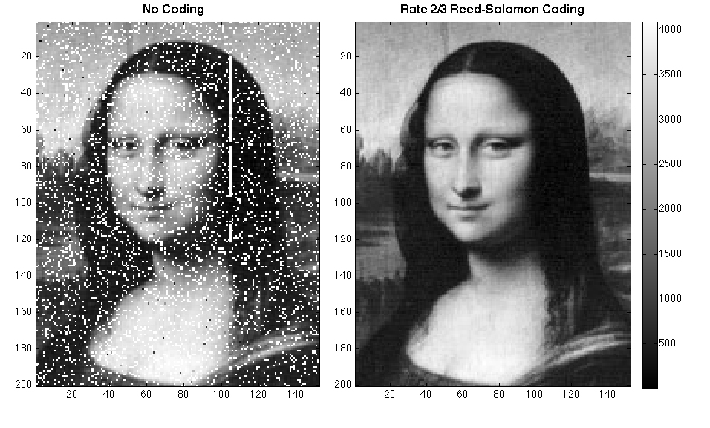
Scenarios

Slide 10

Scenarios

Slide 11
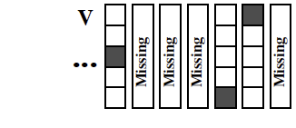
Scenarios

Slide 12
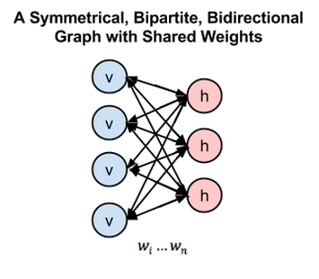
What do they look like?

Slide 13
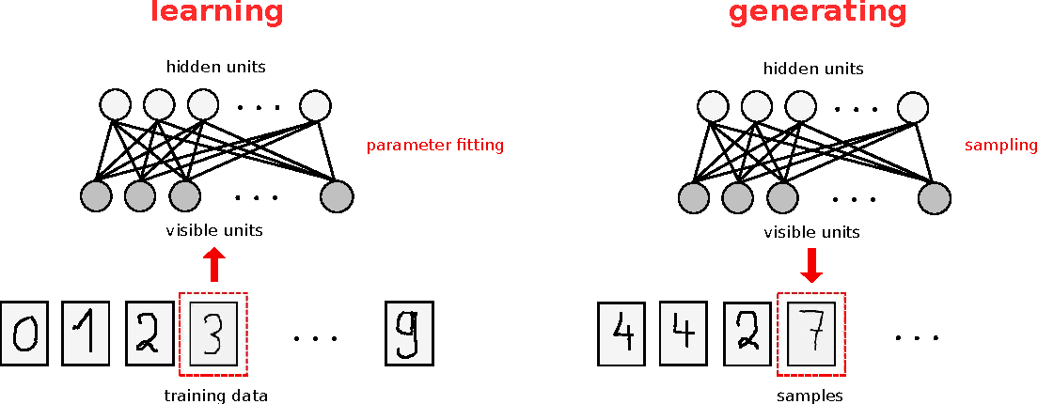
What do they do?

Slide 14
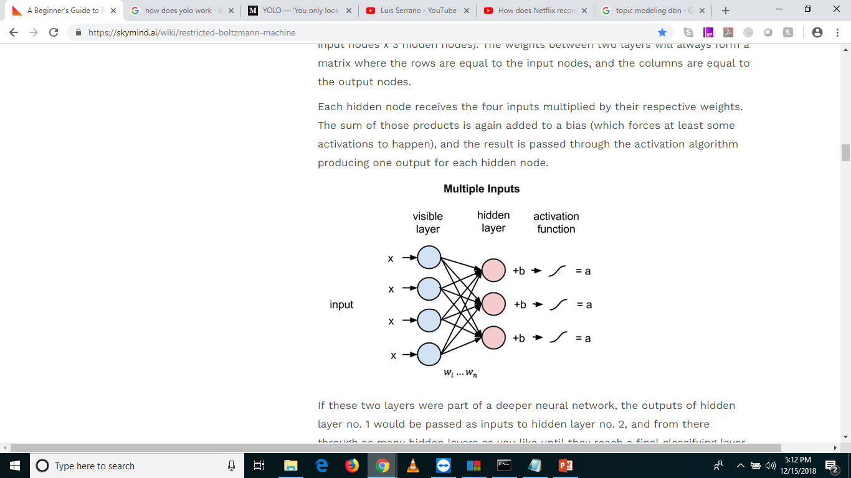
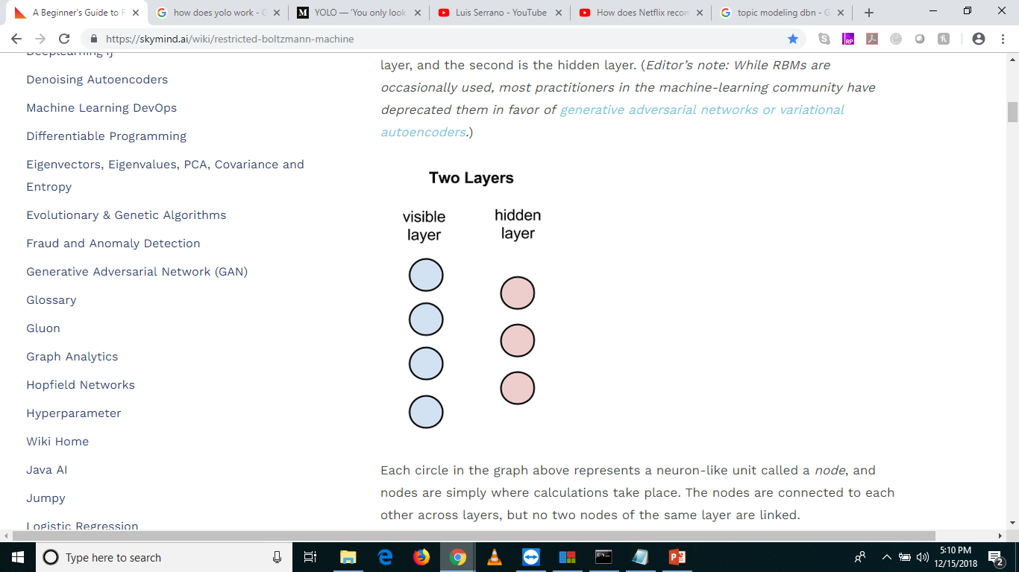
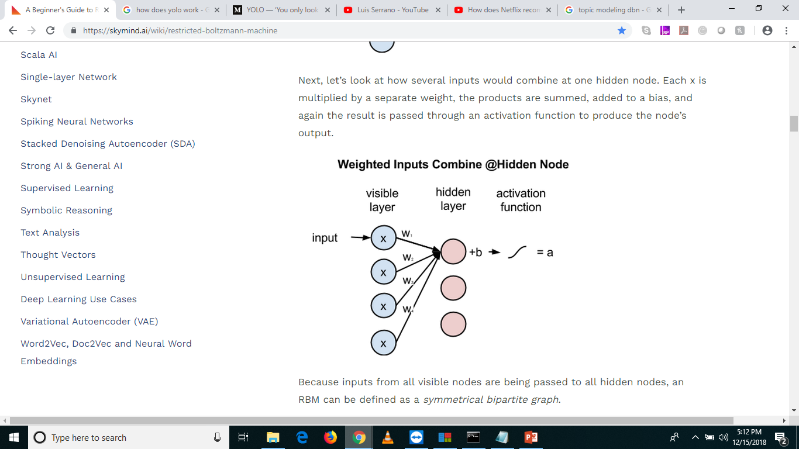
Understanding their operations

Slide 15
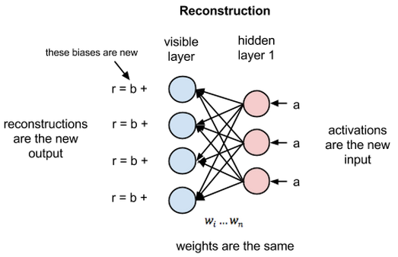
Reconstruction

Slide 16


Different Questions from NN
NN – What operations should I do to convert an input into output?
RBM – Forward - Given these pixels, should my weights send a stronger signal to the elephant node or the dog node?
RBM – Backward - Given an elephant, which distribution of pixels should I expect?

Slide 17
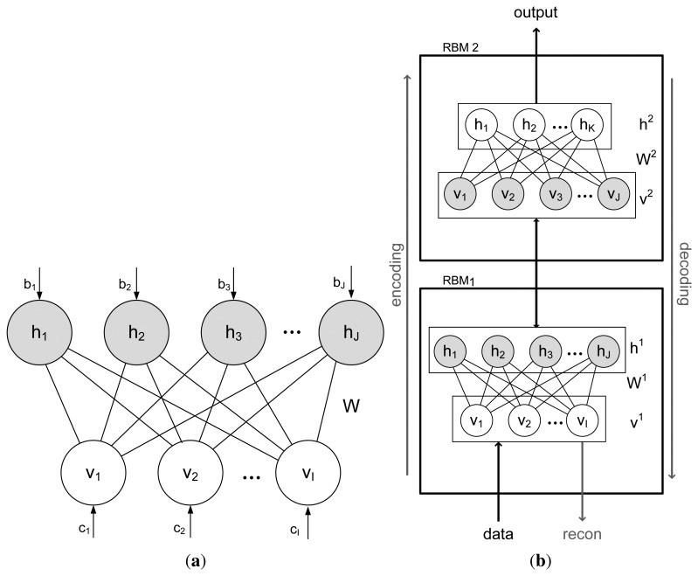
Stacked RBMs

Slide 18
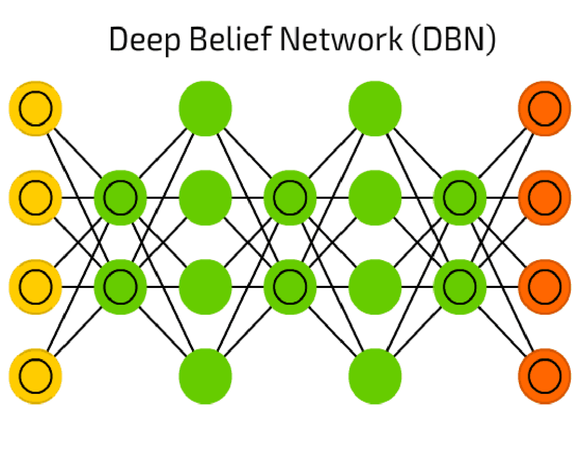
DBN

Slide 19
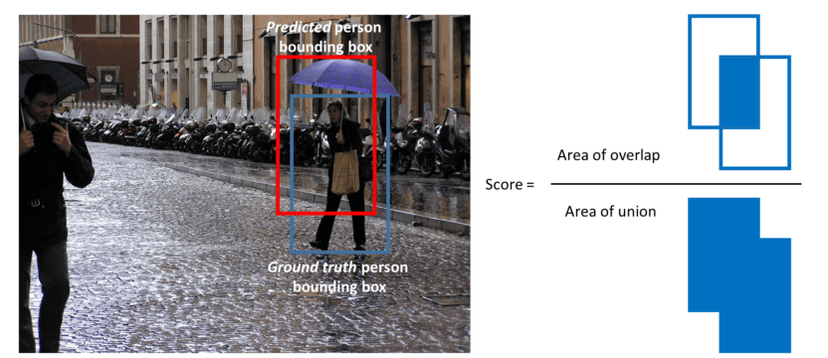
Object Detection

Slide 20
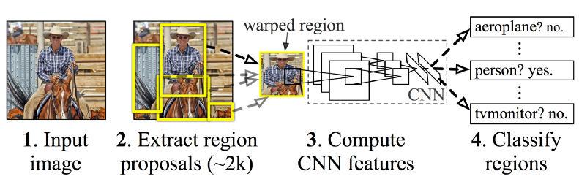
Technically

Slide 21
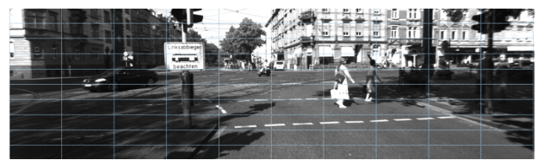
Technically

Slide 22
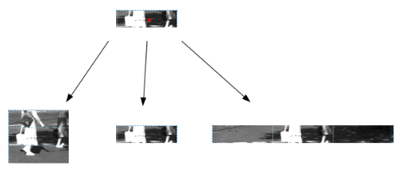
Technically

Slide 23
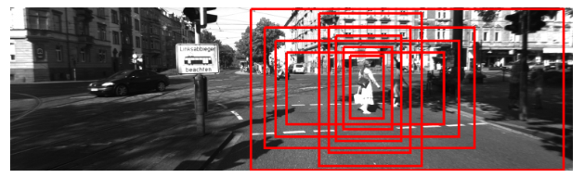
Technically

Slide 24
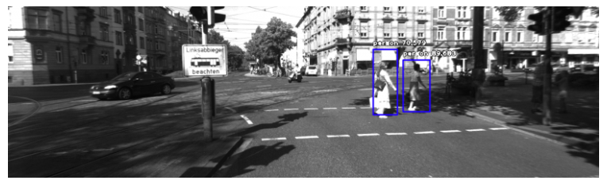
Technically

Slide 25
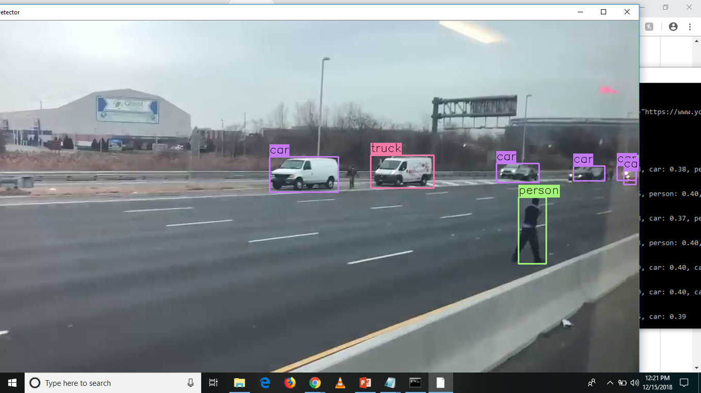
Sample – on youtube url

Slide 26
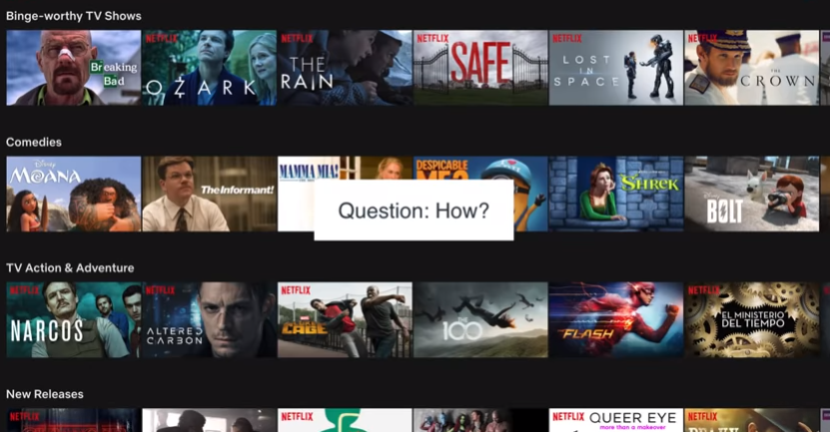
How does Netflix Recommend Movies?

Slide 27
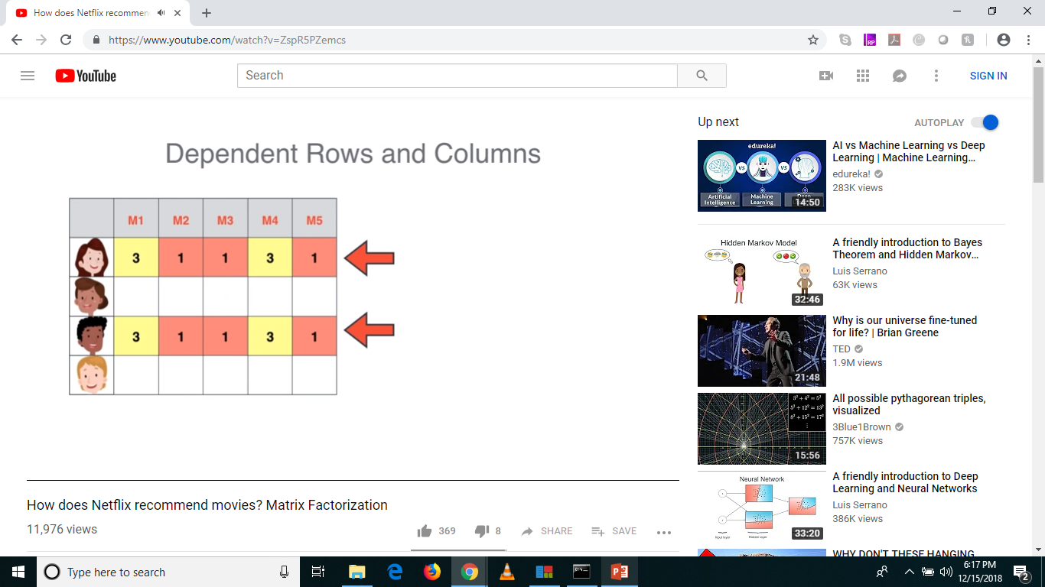
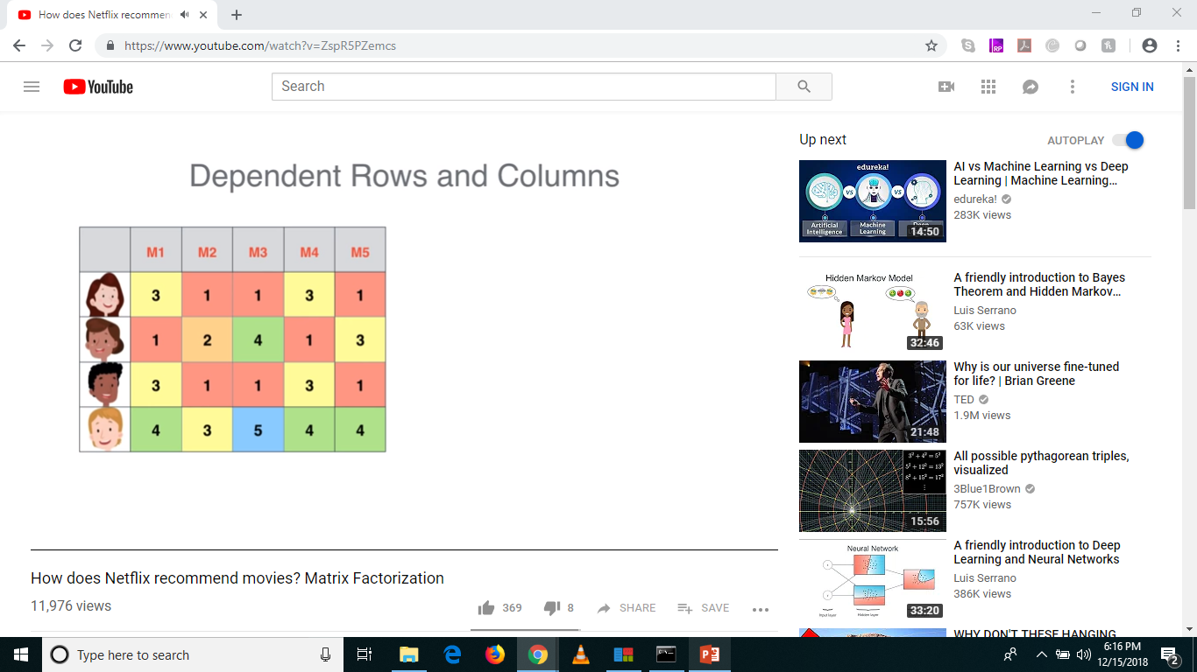
How does Netflix Recommend Movies?

Slide 28
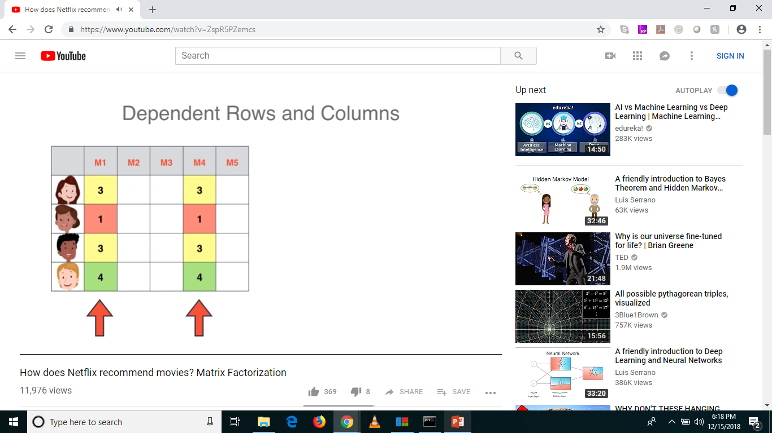
How does Netflix Recommend Movies?

Slide 29
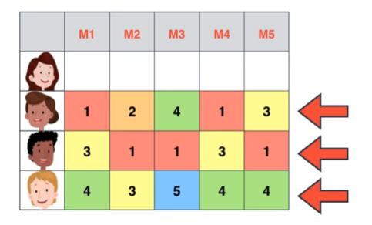
How does Netflix Recommend Movies?

Slide 30
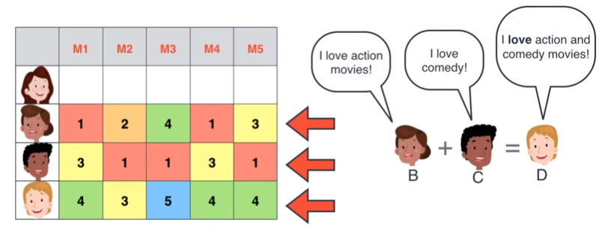
How does Netflix Recommend Movies?

Slide 31
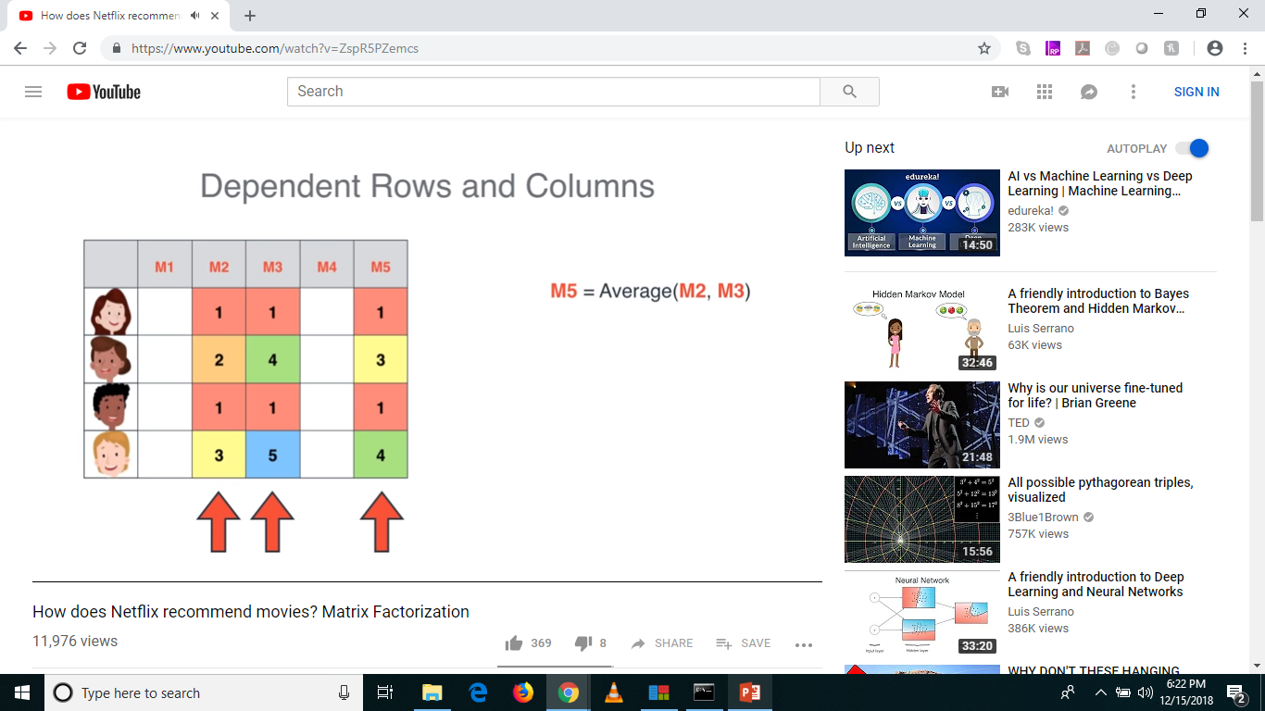
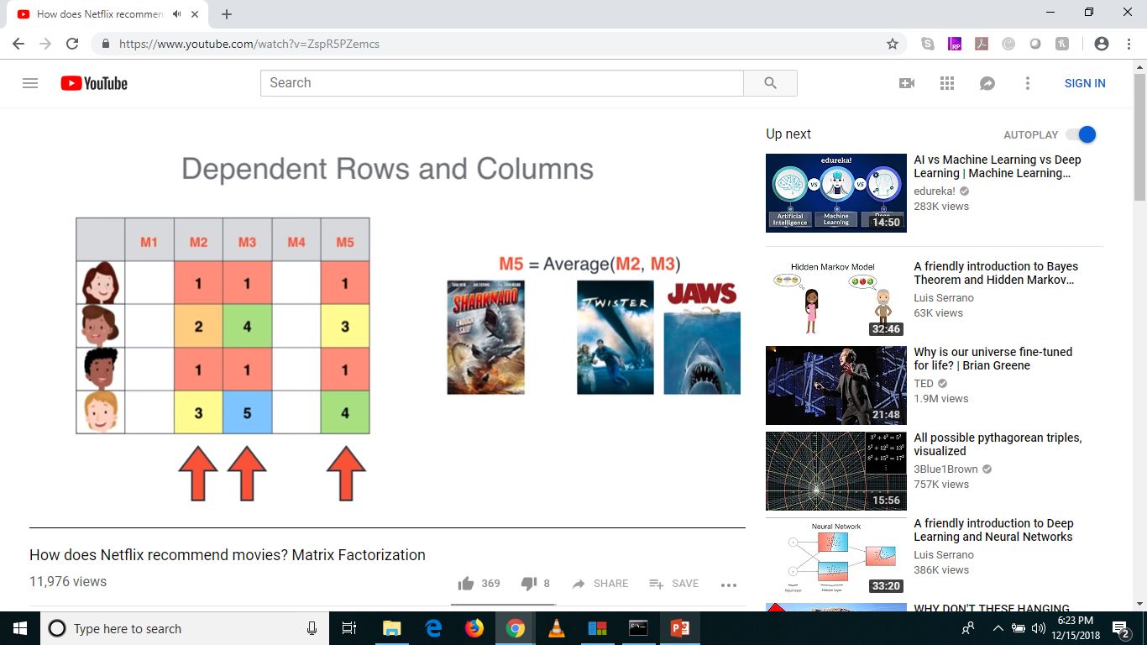
How does Netflix Recommend Movies?

Slide 32
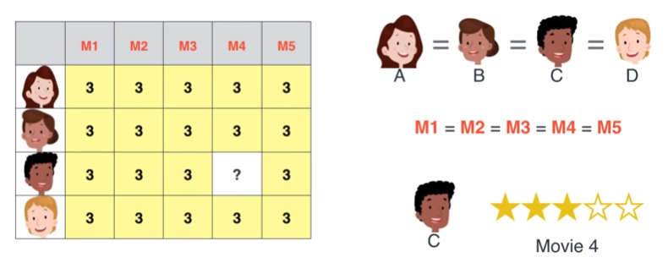
How does Netflix Recommend Movies?

Slide 33
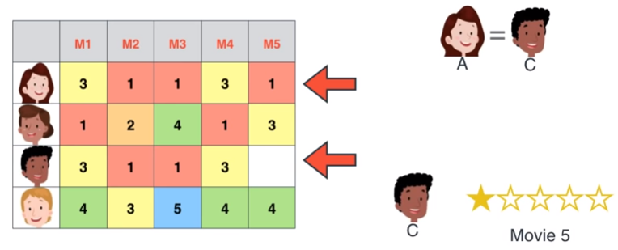
How does Netflix Recommend Movies?

Slide 34
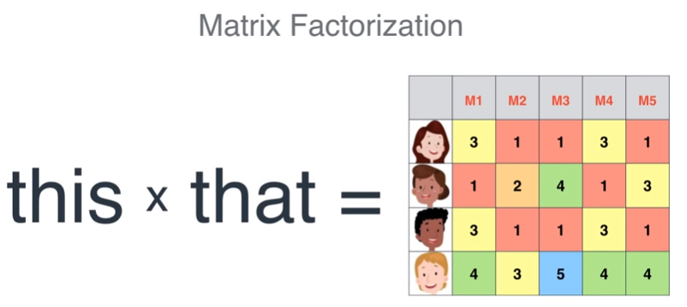
How to determine ratings?

Slide 35

Movie can have many features

Slide 36
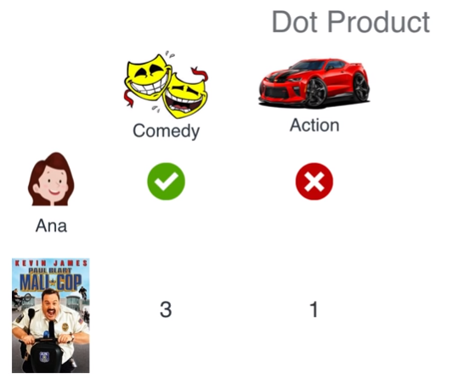
Ratings Calculations?

Slide 37
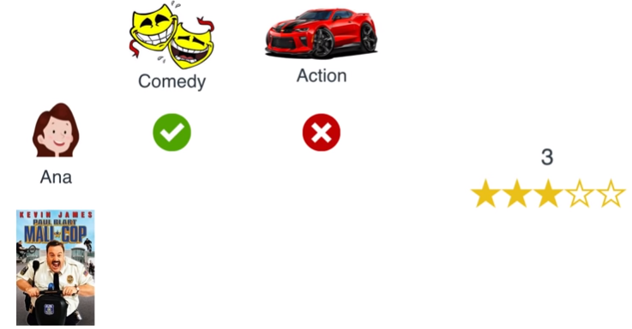
Ratings Calculations

Slide 38
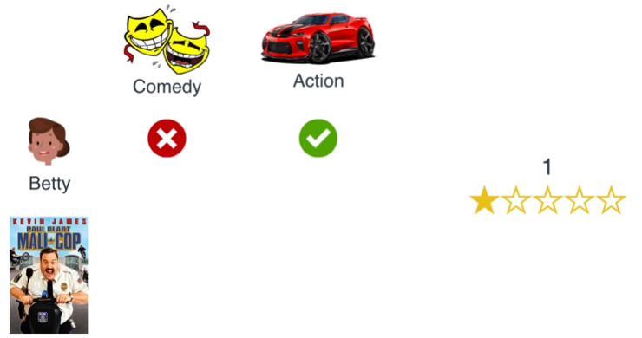
Ratings Calculations

Slide 39
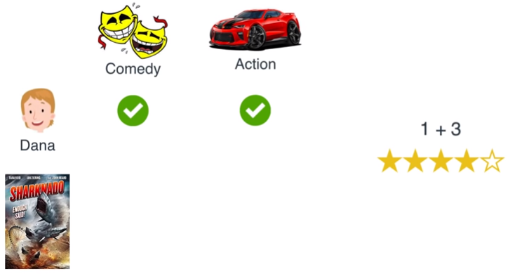
Ratings Calculations

Slide 40
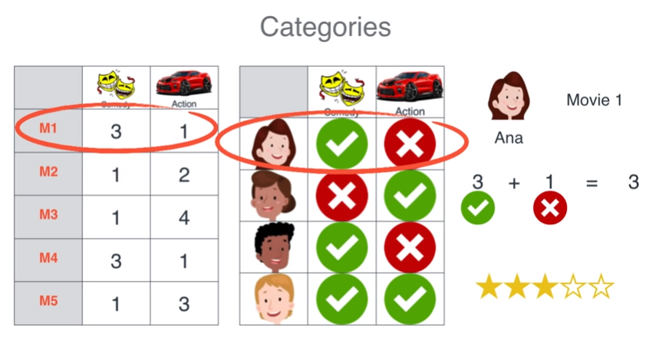
Ratings Calculations

Slide 41
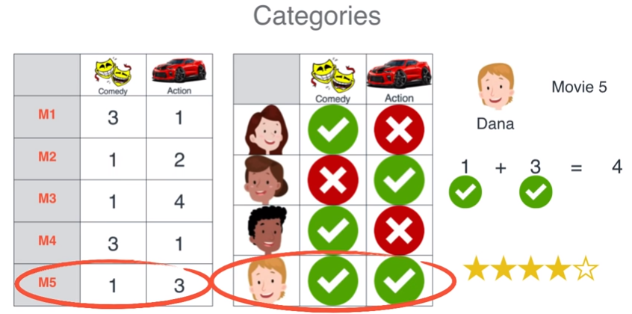
Ratings Calculations

Slide 42
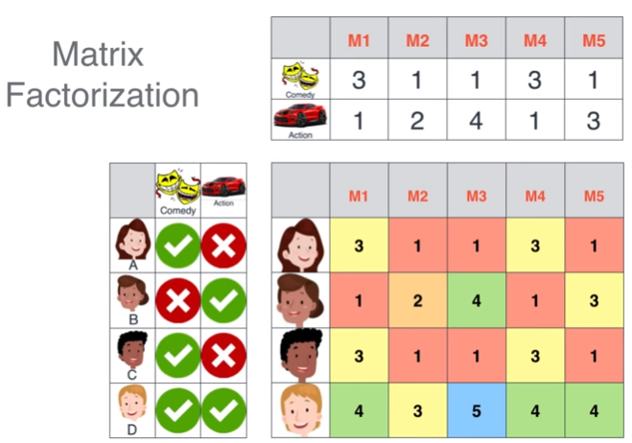
Ratings Calculations

Slide 43

Ratings Calculations

Slide 44
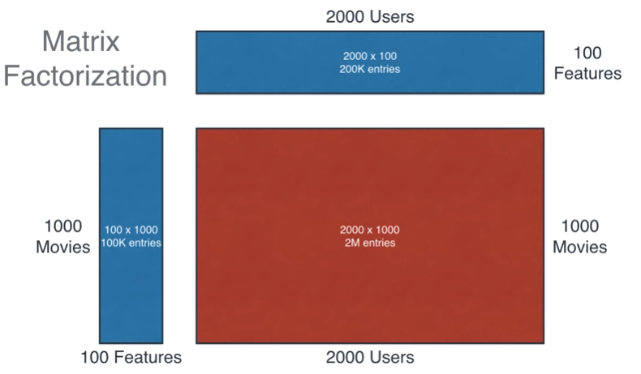
Matrix Factorization

Slide 45
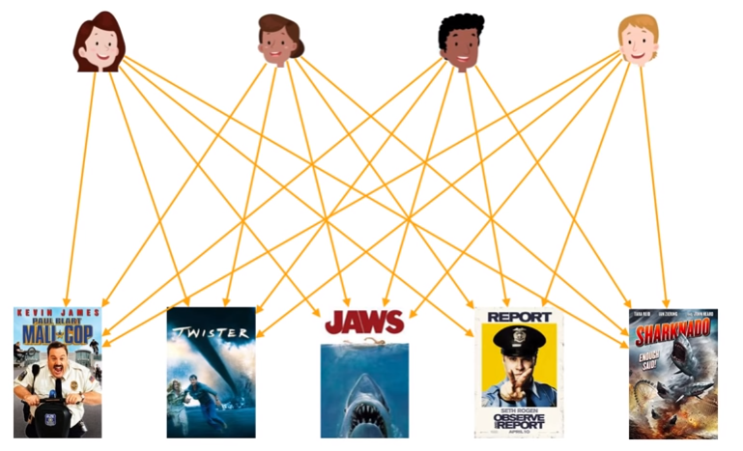
Matrix Factorization

Slide 46
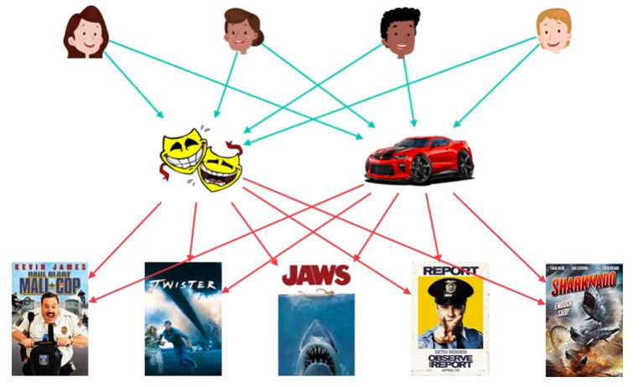
Matrix Factorization

Slide 47
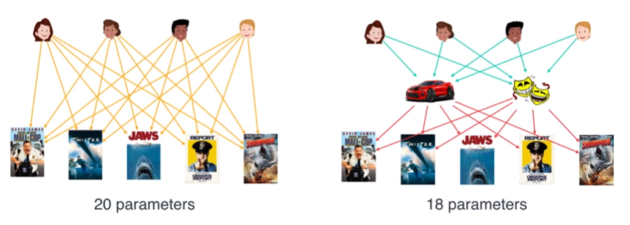
Matrix Factorization

Slide 48
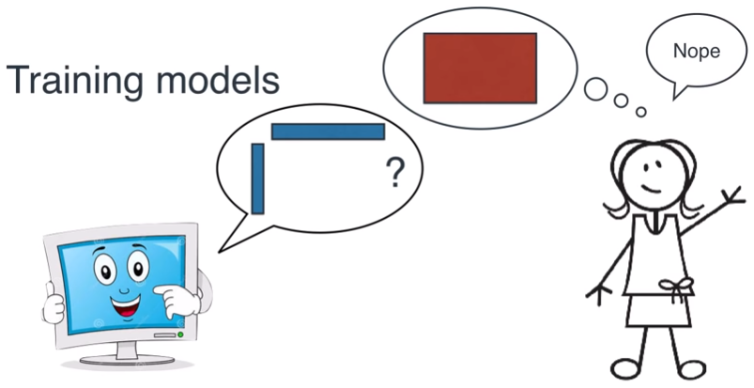
How to find the right factorization values?

Slide 49
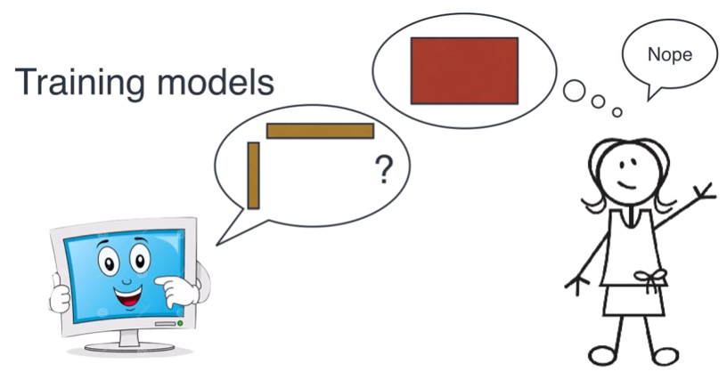
How to find the right factorization values?

Slide 50
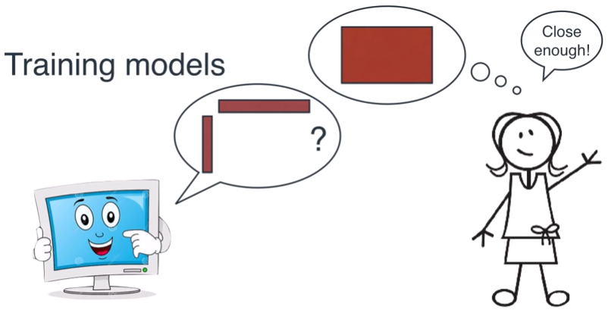
How to find the right factorization?

Slide 51
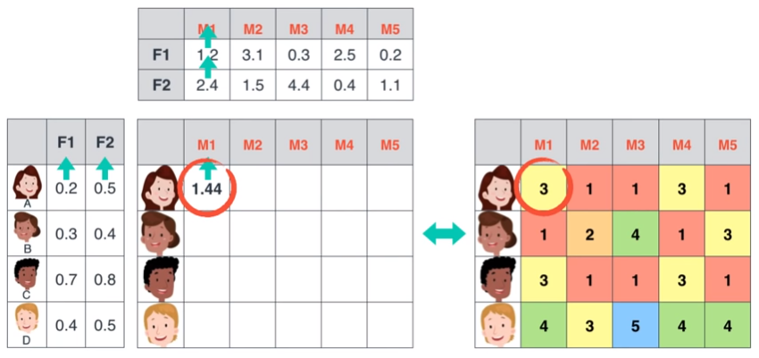
How to find the right factorization values?

Slide 52

How to find the right factorization values?

Slide 53
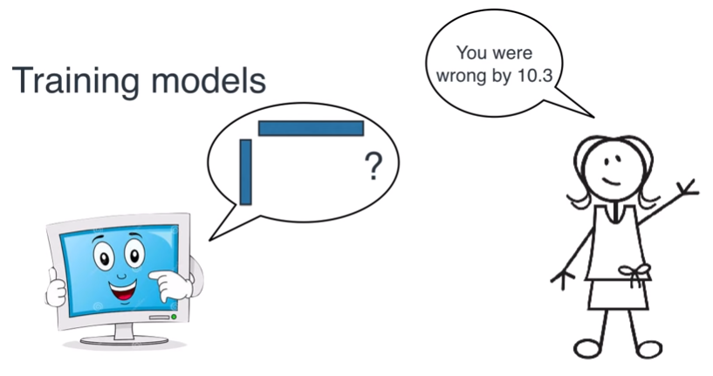
How to find the right factorization values?

Slide 54

How to find the right factorization values?

Slide 55
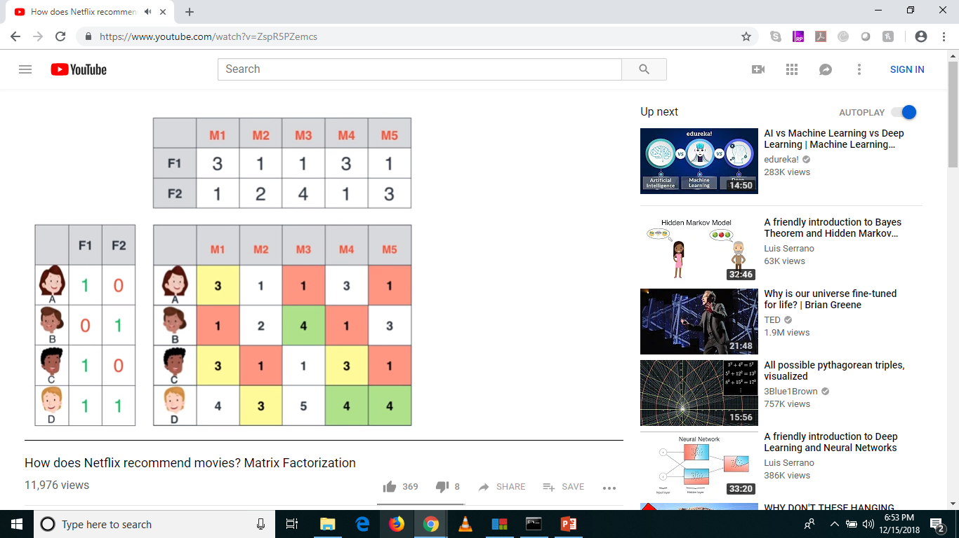
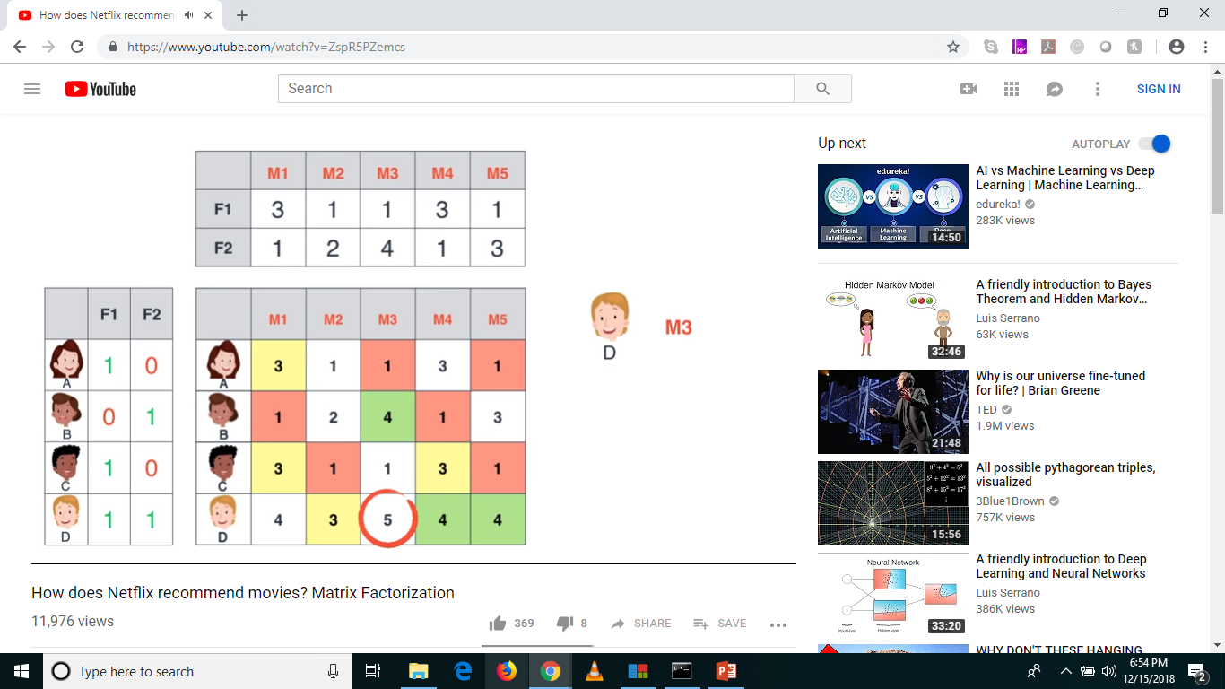

Predicting Ratings

Slide 56
Questions?
Thank you!

